Slide 1
Cloud Computing
Services
Paul S, Morgan H, Jacob K

Slide 2
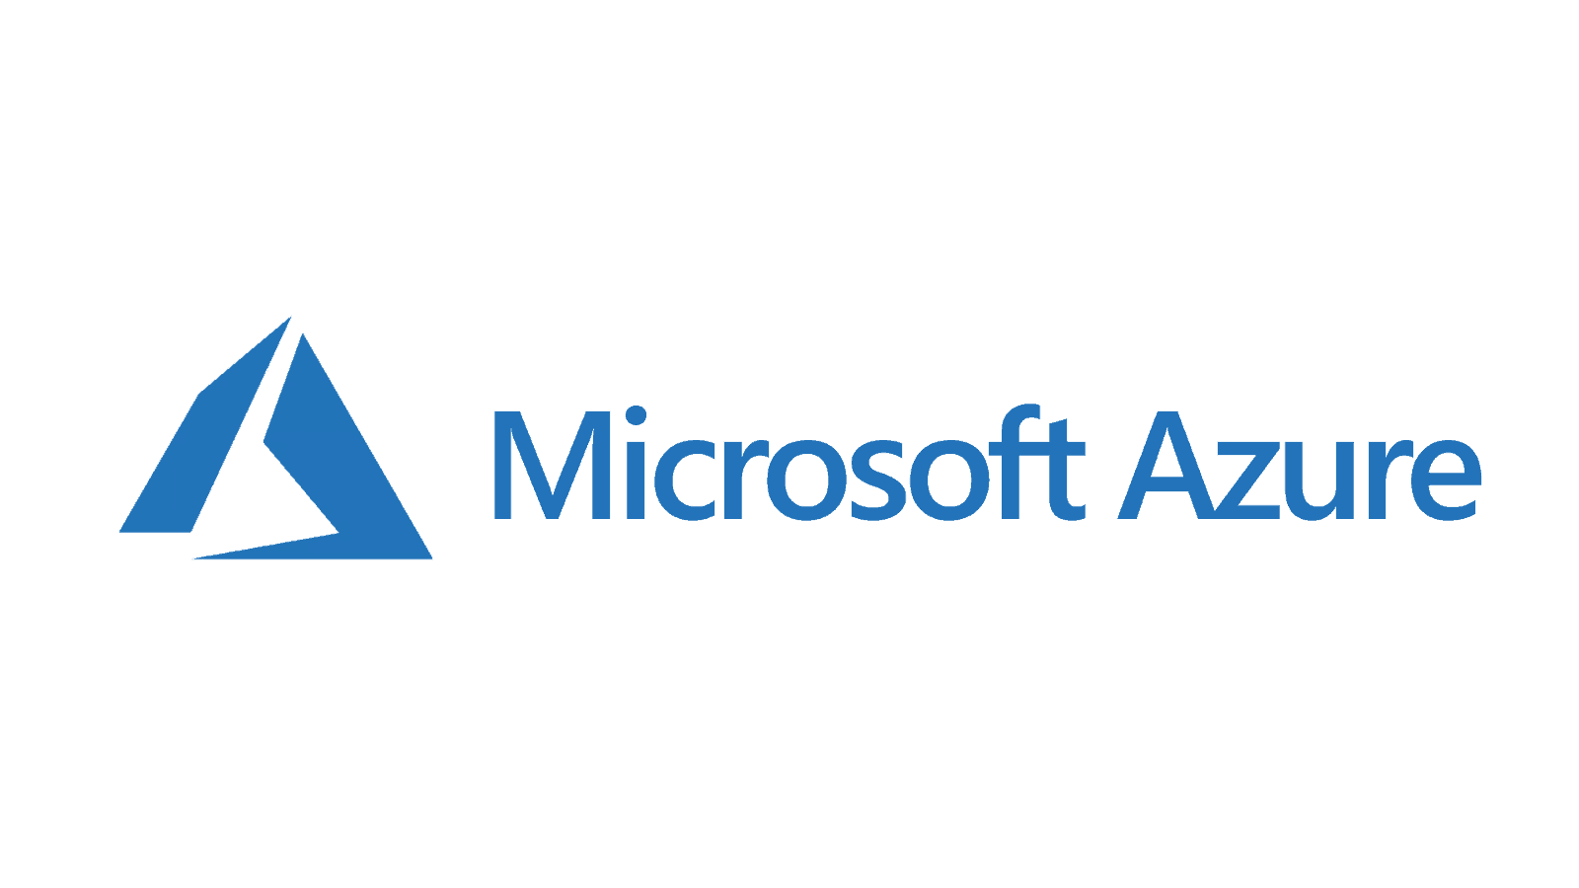
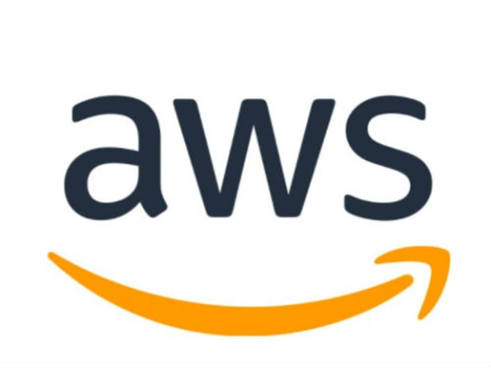
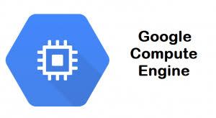
IaaS (Infrastructure as a Service)
Infrastructure as a Service is a cloud-based architecture that allows you to use servers, storage, and networking resources managed by an external company, while your company manages your actual application. Some of the services that IaaS providers provide are storage backup and recovery, log access, data security, and load balancing.
Examples of IAAS:
Microsoft Azure
Amazon Web Services
Google Compute Engine
VMWare

Slide 3
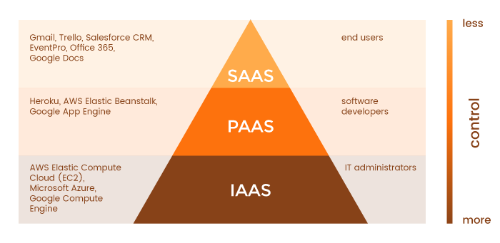
IaaS (Continued)
Advantages of using IaaS:
Businesses can purchase these services as-needed
Businesses still maintain complete control of their infrastructure
Highly scalable
When and why you should use IaaS:
Larger companies can benefit from IaaS because they will retain control over their whole application, but can save money by using “pay for what you use” data centers
Used to ensure your data is safe and can be recovered if issues occur

Slide 4
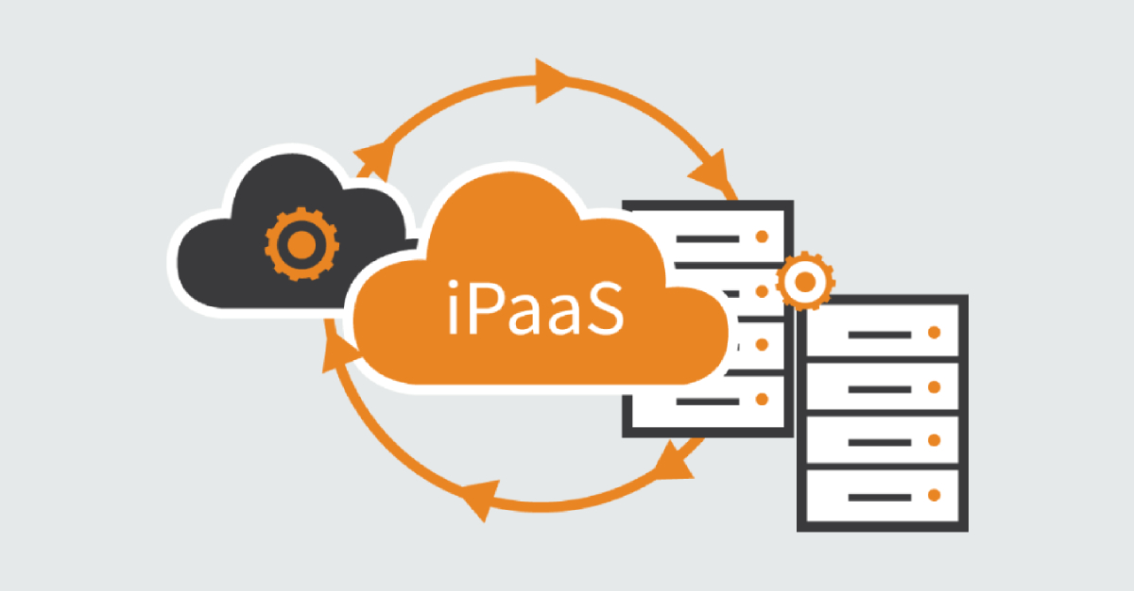
PaaS (Platform as a Service)
Platform as a Service is provides an on demand environment for the full development of software applications.
This service provides the environment.
You provide the applications and data.
Main Benefit:
No need to build and maintain the infrastructure.

Slide 5
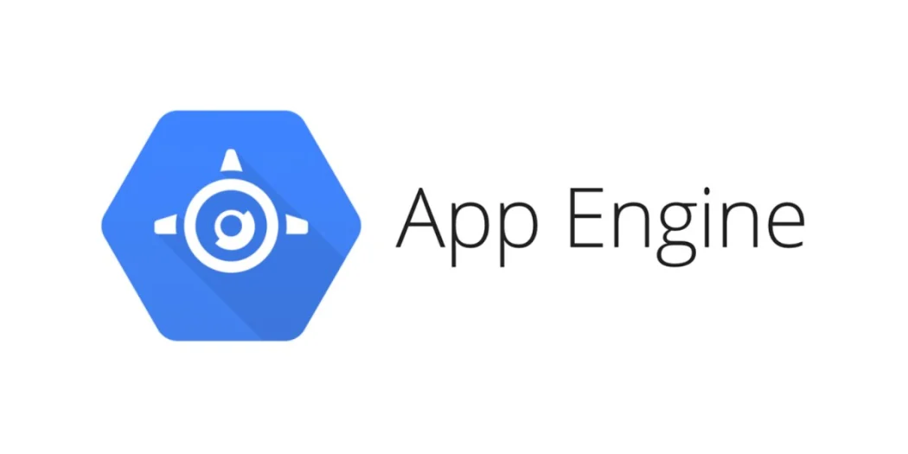
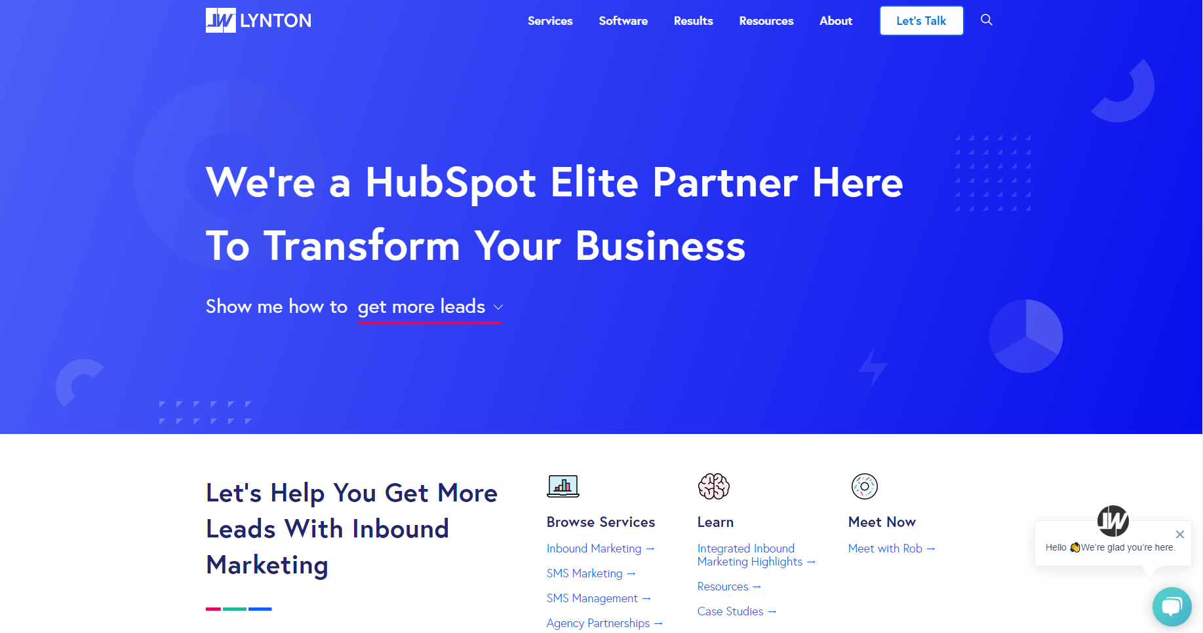
What Uses PaaS?
Use:
Mobile and Web Applications
E.g. Lynton uses Google App Engine as a PaaS)
Cloud Use: Public Cloud
Why (Advantages):
Provides Application Lifecycle Management
Provides Development Tools
Multi Platform Capabilities

Slide 6
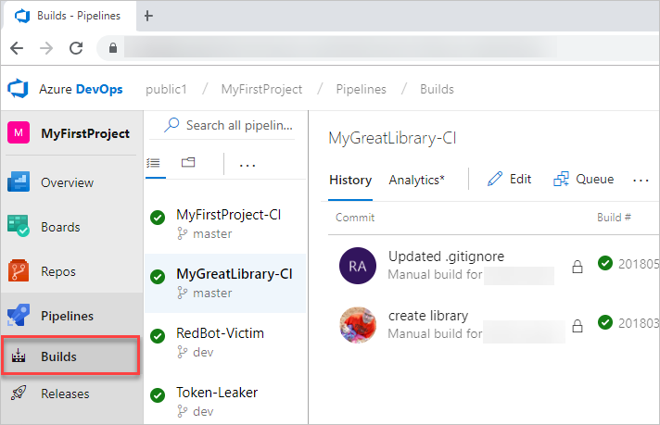
PaaS on Azure
Azure Concrete Case:
Azure allows developers to use software developer kits and Azure DevOps to create and deploy applications quickly and efficiently.

Slide 7

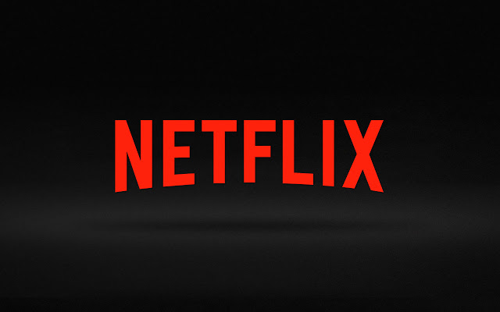
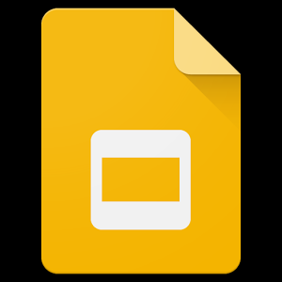
SaaS (Software as a Service)
Every website technically falls under this heading, as they all could be considered “services” that operate online. However, typically SaaS refers to sites that provide a specific, full-featured service, most notably when accompanied by a subscription plan.

Slide 8
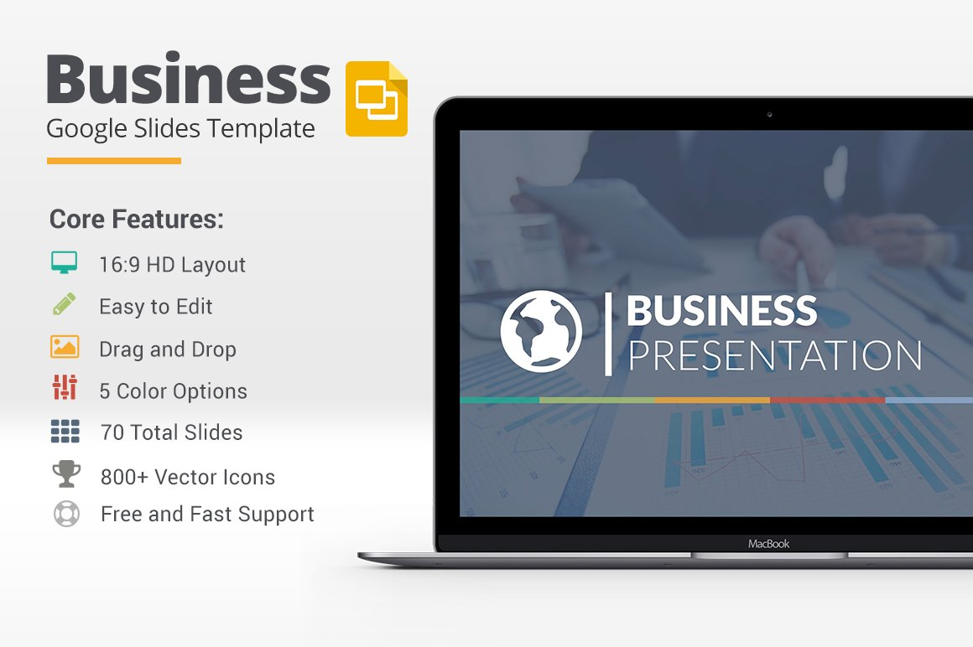
SaaS (Software as a Service)
This very platform, Google Slides, is an example of SaaS. It’s a free web service, with an optional paid version for businesses, and it is maintained almost entirely online. There are no physical components to install, no separate applications necessary to download. There are mobile app versions of course, but they are technically within their own category.

Slide 9

SaaS (Software as a Service)
For Google’s purposes, this design makes the most sense. They wanted an easy-to-use, easily available version of Microsoft’s Powerpoint. Keeping it entirely online as a SaaS means no time waiting for it to download, no extra storage space or computing power on your computer necessary. Just a “one-stop-shop” for your presentation needs.

Slide 10

SaaS (Software as a Service)
Needless-to-say, Slides is a Public Cloud service, as most SaaS’s are. They own and maintain their own hardware, while their services are open to the public. For these types of businesses, no other type of cloud service would be feasible.
Similarly, Azure offers a Live and On-Demand Streaming service for media, which allows you to “Deliver content to virtually any device at scale”. This too is an example of SaaS, on a public cloud.

Slide 11
Sources
https://azure.microsoft.com/en-us/overview/what-is-paas/
https://searchcloudcomputing.techtarget.com/definition/Platform-as-a-Service-PaaS
https://www.bmc.com/blogs/saas-vs-paas-vs-iaas-whats-the-difference-and-how-to-choose/
https://rubygarage.org/blog/iaas-vs-paas-vs-saas#article_title_6
https://searchcloudcomputing.techtarget.com/definition/Infrastructure-as-a-Service-IaaS
https://www.google.com/slides/about/
https://en.wikipedia.org/wiki/Software_as_a_service
https://azure.microsoft.com/en-us/services/media-services/live-on-demand/

